Slide 1
Peer Reviews – Sendai Framework for Disaster Risk Reduction

Slide 2
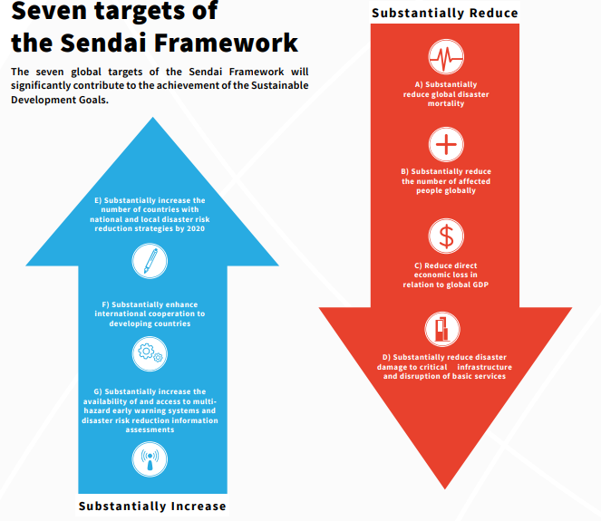

Slide 3
Global target E: Substantially increase the number of countries with national and local disaster risk reduction strategies by 2020.
E-1 Number of countries that adopt and implement national disaster risk reduction strategies in line with the Sendai Framework for Disaster Risk Reduction 2015-2030.
E-2 Percentage of local governments that adopt and implement local disaster risk reduction strategies in line with national strategies

Slide 4

Risk-informed DRR measures
Economic
Structural
Legal
Social
Health
Cultural
Educational Environmental Technological Political
Institutional
Notes:
The Goal:
Prevent new and reduce existing disaster risk through the implementation of integrated and inclusive economic, structural, legal, social, health, cultural, educational, environmental, technological, political and institutional measures that prevent and reduce hazard exposure and vulnerability to disaster, increase preparedness for response and recovery, and thus strengthen resilience.
You need to know your risk to make sure your work is goind to achieve the DRR objective

Slide 5
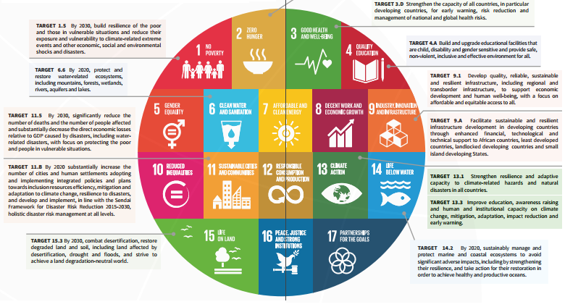

Slide 6
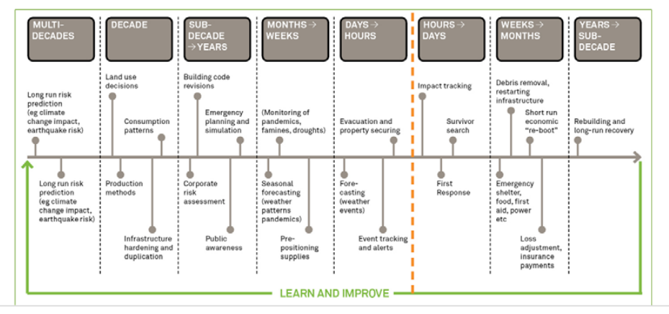
Building resilience is a process

Slide 7
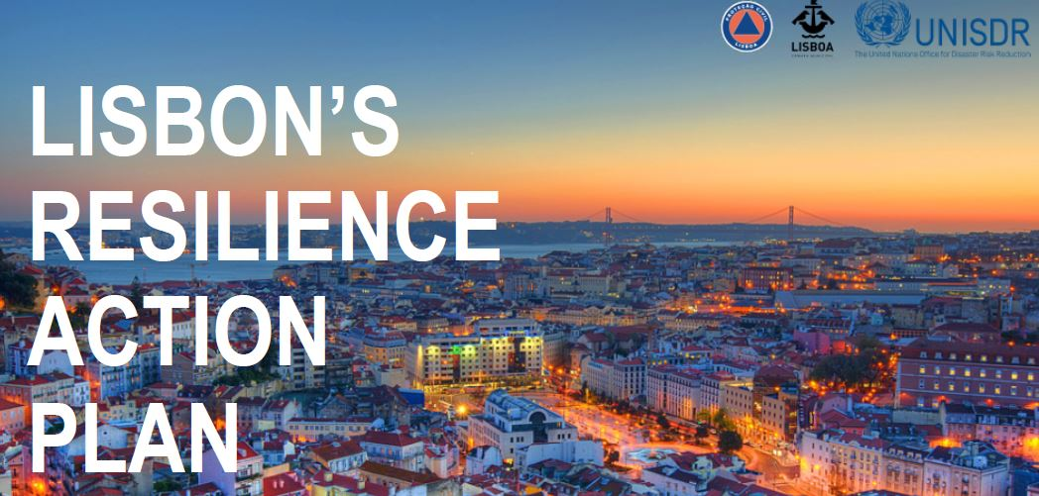
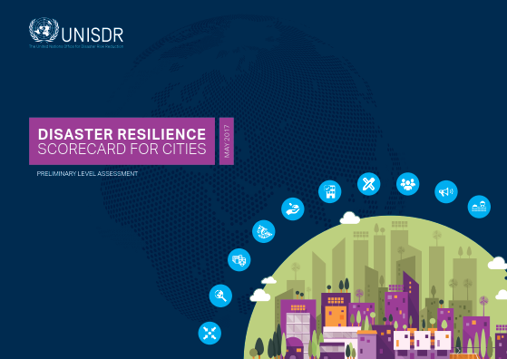
Making Cities Resilient
4107 cities globally
1 billion people
73 Capital Cities
100 cities > 1 million people
99 countries

Slide 8
Current global efforts
Resilience Strategy / Plan of Action
Access to finance and resources
Reporting and evaluations
Capacity building
Research and access to knowledge
Solutions and specific implementation
Data and evidence
Response / humanitarian

Slide 9
Sendai and the Peer Review approach
Priority 1 – Understanding Disaster Risks
Para 24(g) – At national / local level « To build the knowledge of government officials at all levels, civil society, communities and volunteers, as well as the private sector, through sharing experiences, lessons learned, good practices and training and education on disaster risk reduction, including the use of [...] peer learning »

Slide 10
Priority 2 – Strengthening disaster risk governance to manage disaster risk
27(g) – National / Local action around mainstreaming, DRR strategies, risk management capacity assessments, enhance reporting and scrutiny, role of coordination forums / Focal Points
28(e) – At Global / Regional level « To promote mutual learning and exchange of good practices and information through, inter alia, voluntary and self-initiated peer reviews among interested States »

Slide 11
Purpose of Local Peer Review
In practice: Assess situation, validate actions, identify gaps and share recommendations
Achieve: Mutual learning, sharing of practices, policy dialogue and trust building
Aim: Promote integrated approach to DRR

Slide 12
Going forward
Sendai implementation and monitoring
Advocate good practices – U-SCORE II results
MCR Campaign - European potential and future
Sustain the peer review approach: regional initiatives? new instruments?
Link, share and learn: other peer review initiatives –European Union / UCPM; OECD

Slide 13
Making Cities Resilient to Disasters
https://www.unisdr.org/campaign/resilientcities/
Abhilash Panda
Regional Office for Europe and Central Asia pandaa@un.org

